Slide 1

Employee Management
System
Prepared by:
Atharva Shirwalkar
Batch no: 361
Mentored by: Manisha

Slide 2
About me
Background ?
Atharva Shirwalkar: Bachelor of Engineering (Mechanical)
Why did I want to learn Data Science?
As a working professional in quality department, I had to deal with large amounts of data on daily basis.
My profile required me to make data driven decisions for a smooth functionality of supply chain.
This hands-on exposure gradually ignited my interest in understanding how data could be leveraged more efficiently and intelligently.
These experiences helped me to find my passion in this profession.
Any work experience?
Atharva Shirwalkar: 1.5+ Years Experience as Quality Control Engineer
Share your linkedin and github profile urls:
Atharva’s LinkedIN : https://www.linkedin.com/in/atharva-shirwalkar-5a5071350
Atharva’s GitHub: https://github.com/Atharva9912

Slide 3
Objective:
The objective of this project is to design and implement an Employee Management System that efficiently stores and manages employee-related data within an organization. This system tracks various aspects of employee information, including personal details, job roles, salary structures, qualifications, leave records, and payroll data.
System integrity and consistency was achieved by using relational tables with appropriate foreign keys and cascading actions.
This system allows easy management and querying of employee data, providing insights such as payroll calculation, leave tracking, and department-specific job roles.
The goal is to streamline HR operations, ensuring that all relevant employee data is accessible and accurately updated across different modules.
Tools used:
MySQL Workbench
PowerPoint

Slide 4
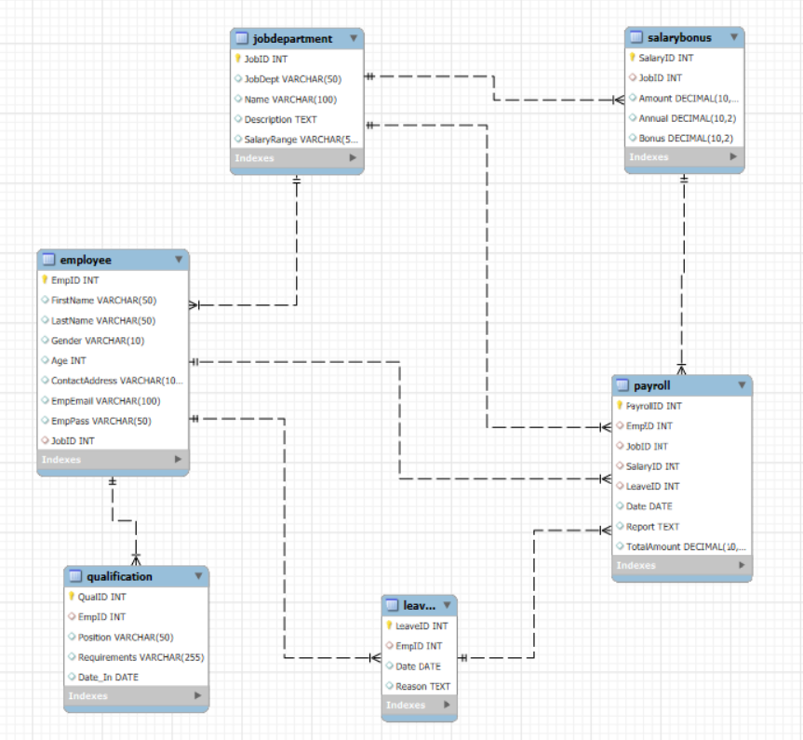
ER DIAGRAM:

Slide 5
KEY ANALYSIS QUESTIONS:
EMPLOYEE INSIGHTS
JOB ROLE AND DEPARTMENT ANALYSIS
QUALIFICATION AND SKILLS ANALYSIS
LEAVE AND ABSENCE PATTERNS
PAYROLL AND COMPENSATION ANALYSIS
EMPLOYEE PERFORMANCE AND GROWTH

Slide 6
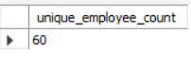
EMPOYEE INSIGHT PROBLEMS:
How many unique employees are currently in the system?
Query:
Output:

Slide 7
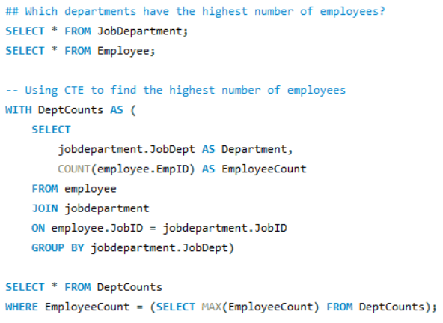
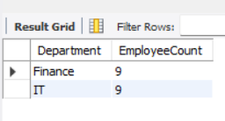
Which departments have the highest number of employees?
Query:
Output:

Slide 8
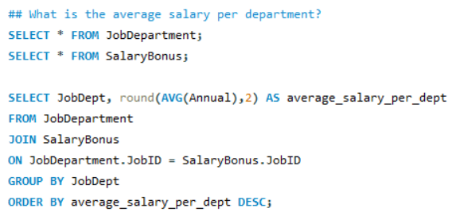
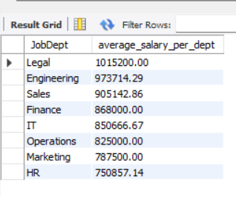
What is the average salary per department?
Query:
Output:

Slide 9
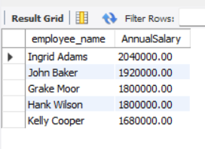
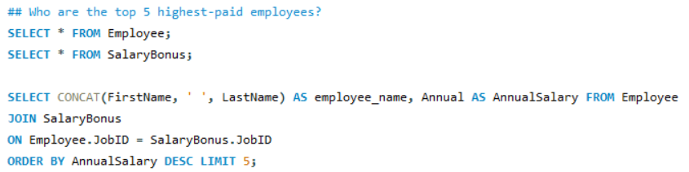
Who are the top 5 highest-paid employees?
Query:
Output:

Slide 10


What is the total salary expenditure across the company?
Query:
Output:

Slide 11
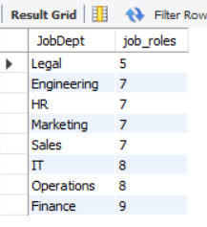
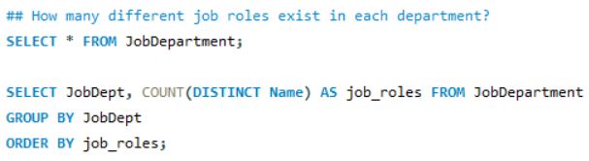
JOB ROLE AND DEPARTMENT ANALYSIS PROBLEMS:
How many different job roles exist in each department?
Query:
Output:

Slide 12
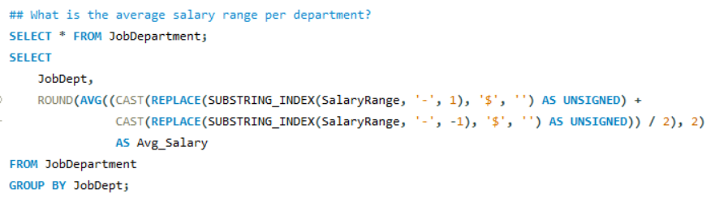
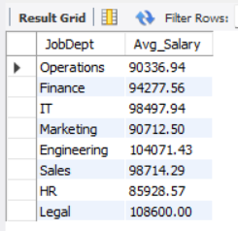
What is the average salary range per department?
Query:
Output:

Slide 13
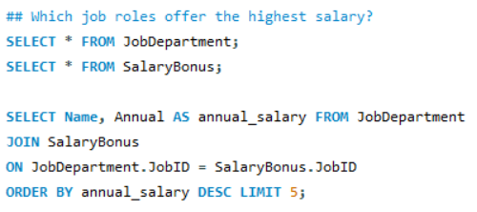
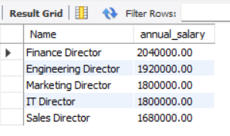
Which job roles offer the highest salary?
Query:
Output:

Slide 14
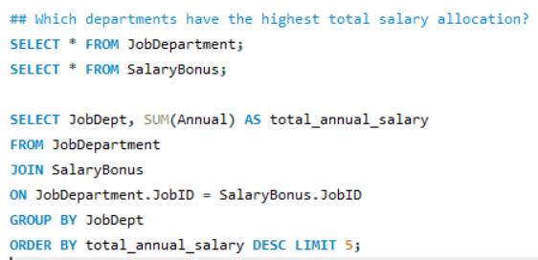
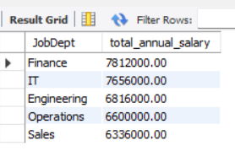
Which departments have the highest total salary allocation?
Query:
Output:

Slide 15
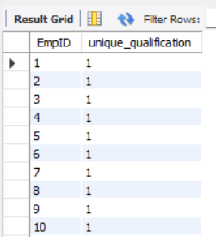
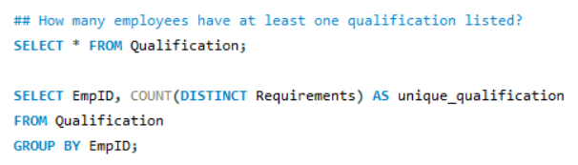
QUALIFICATION AND SKILLS ANALYSIS PROBLEMS:
How many employees have at least one qualification listed?
Query:
Output:

Slide 16
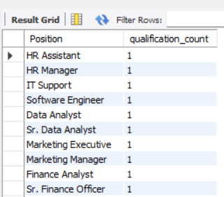
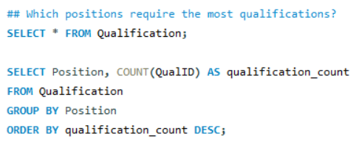
Which positions require the most qualifications?
Query:
Output:

Slide 17
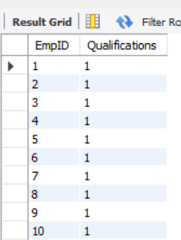
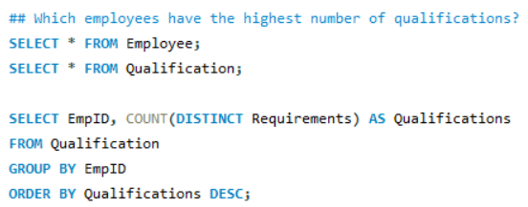
Which employees have the highest number of qualifications?
Query:
Output:

Slide 18
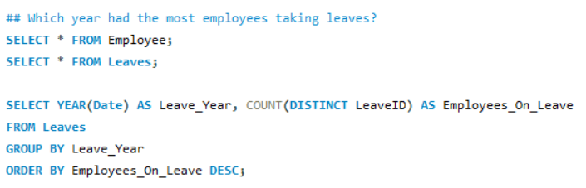
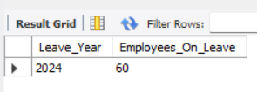
LEAVE AND ABSENCE PATTERN PROBLEMS:
Which year had the most employees taking leaves?
Query:
Output:

Slide 19
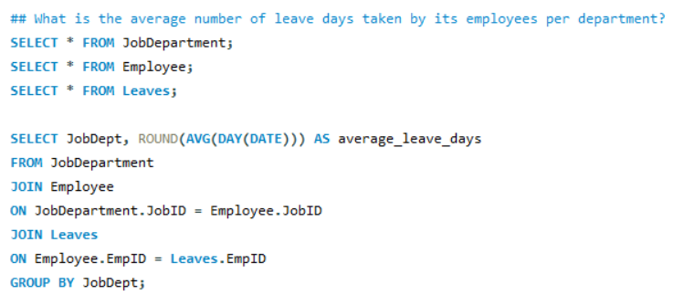
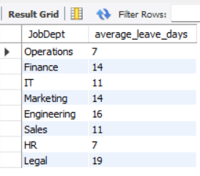
What is the average number of leave days taken by its employees per department?
Query:
Output:

Slide 20
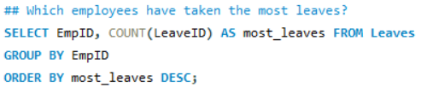
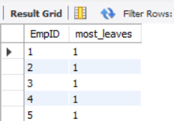
Which employees have taken the most leaves?
Query:
Output:

Slide 21


What is the total number of leave days taken company-wide?
Query:
Output:

Slide 22
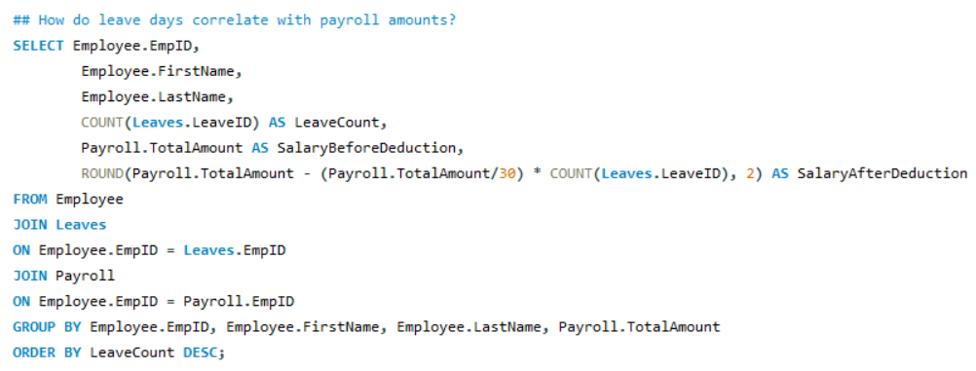
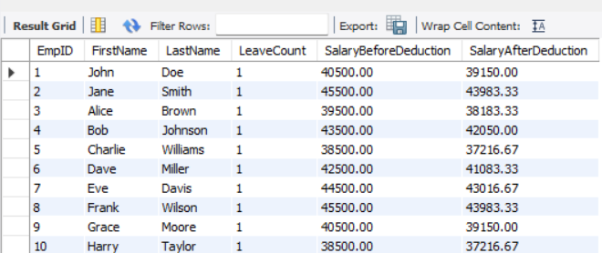
How do leave days correlate with payroll amounts?
Query:
Output:

Slide 23

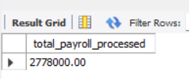
PAYROLL AND COMPENSATION ANALYSIS PROBLEMS:
What is the total monthly payroll processed?
Query:
Output:

Slide 24
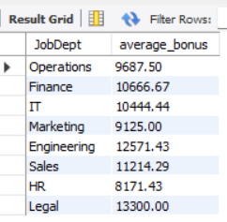
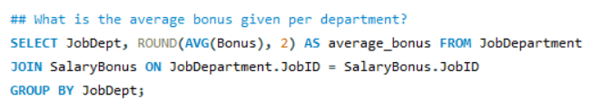
What is the average bonus given per department?
Query:
Output:

Slide 25
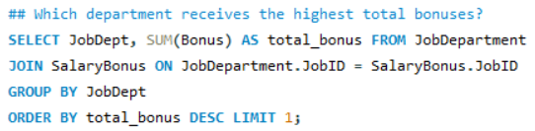

Which department receives the highest total bonuses?
Query:
Output:

Slide 26
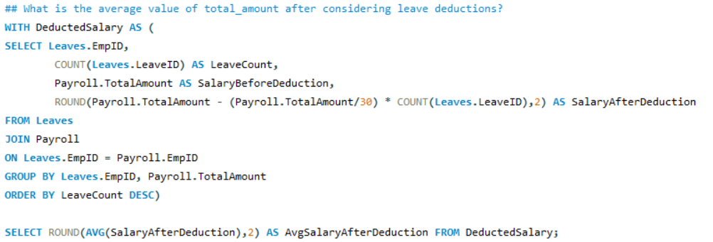

What is the average value of total_amount after considering leave deductions?
Query:
Output:

Slide 27
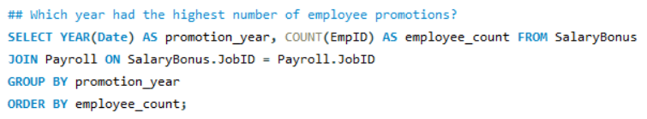

EMPLOYEE PERFORMANCE AND GROWTH PROBLEM:
Which year had the highest number of employee promotions?
Query:
Output:

Slide 28
BUSINESS INSIGHTS:
Finance and IT departments have the highest employee count, and also have the highest total salary allocation. But based off the data, Legal and Engineering departments have the highest average salaries despite having less employees.
The company distributes a whopping total of $52 million dollars in salary expenditure.
Operations and Finance departments provide most number of job roles while Legal has the lowest number of job roles.
The directors of Finance and Engineering departments have the highest annual salaries across the company.
The year 2024 saw employees taking most number of leaves where employees from the Engineering and Marketing departments had the highest percentage of leave days. Hence, there was a negative impact on the salaries of employees of these departments.
Legal and Engineering had the highest average bonus while HR had the lowest average bonus across all departments.
According to the data, most number of promotions were given in the year 2024.

Slide 29
Conclusion:
In summary, the company demonstrates targeted compensation strategies and focused investments in core departments, but must address workload balance, leave management, and bonus equity to ensure long-term employee satisfaction and financial sustainability.

Slide 30

THANK YOU

